Slide 1
Chapter 6: Macro Synthesis
Guidelines
Reuse Methodology Manual for System-On-Chip Designs
Notes:
This is the light cover slide option.

Slide 2
6 Macro Synthesis Guidelines
The guidelines discussed in this chapter :
-Developing synthesis scripts to help integrators to synthesis macros & to meet timing . -Synthesis strategies for reusable macro . – High-performance synthesis . –Guidelines for RAM & data-path generators . –Coding guidelines for synthesis scripts .

Slide 3
6 Macro Synthesis Guidelines
6.1 Overview of the Synthesis Problem
For soft macros designs : Synthesis and timing design must start at the beginning of the macro design cycle as follows: -Functional specifications for the macro must describe the timing, area, and power requirements for the design.
-For timing critical blocks detailed technical specs. should be provided such as : Tehcnical specs for macro and its sub-blocks describing timing , interfaces in details (Ex. Inputs and outputs delays and loading ) .
- RTL coding should aim to meet both timing and functionality , as the approach of functionality comes first then fixing timing issues can cause an overall poor performance . If those guidlines are followed , then macro meets timing as each module follows its timing budget .

Slide 4
6 Macro Synthesis Guidelines
6.2 Macro Synthesis Strategy
There ‘re two main synthesis strategies :
Top-down strategy | bottom-up strategy
-It consists of setting top-level constrains then letting the tool partition timing between inside blocks . -Synthesis is done in one pass on the entire macro . -It’s advisable for the designs under 10K gates , as it gives a good results in this range . -Simpler strategy in case design is well partitioned . | -It consists of setting constrains for each module inside the macro . -Syhthesis is done on the lowest block first then performed on the higher levels. -It’s advisable for the designs larger than 100K gates , or desings that has aggressive performance goals. -It leads to faster runtime .

Slide 5
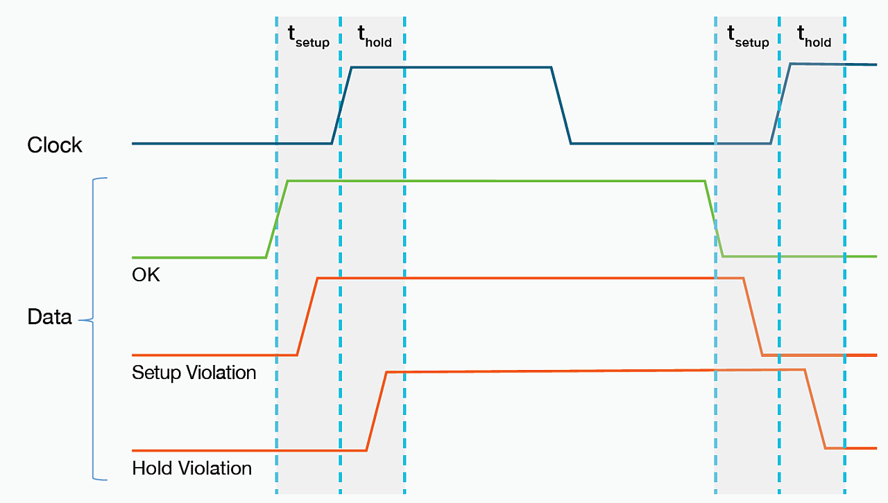
6 Macro Synthesis Guidelines
6.2.1 Macro Timing Constraints
Rule – Timing budget must be defined at the specification process before the design is partitioned into blocks or coded , and should be reviewed during the design to make sure it’s still reasonable . To fully define a timing budget the following specs. must be specified:
Clock definition (Clk-period , Duty-cycle, ...) create_clock -period <number_in_ns> -waveform <arg1 arg2 ...> \ [get_ports <clock_port_name>] Where arg1 & arg2 are the rising and failing times of the waveform
Setup time requirements for all signals going into the macro.

Slide 6
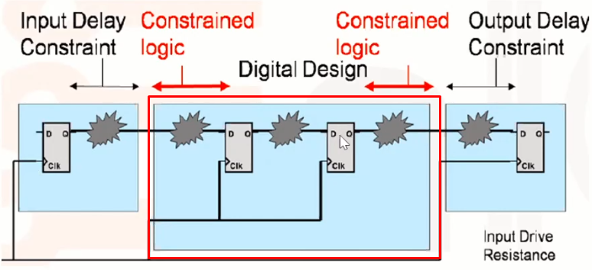
6 Macro Synthesis Guidelines
6.2.1 Macro Timing Constraints
Clock-to-outputdelay requirements for all synchronous outputs of the macro . (tcq).
Input and output delays for all combinational paths through the macro . set_input_delay -max <number_in_ns> -clock <clock_name> [remove_from_collection[all_inputs] \ [get_ports <clock_port_name>]] #Set the input delay constraint to a specific value
set_output_delay -max <number_in_ns> -clock <clock_name> [all-outputs]

Slide 7
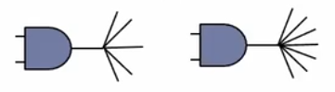
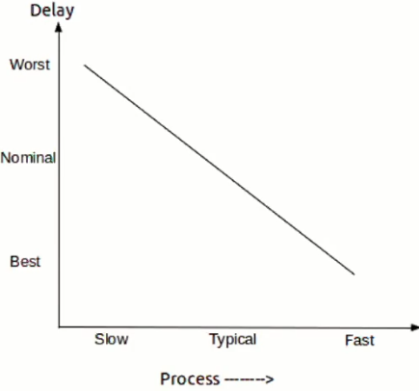
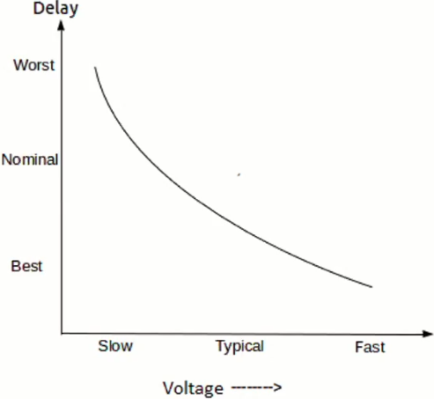
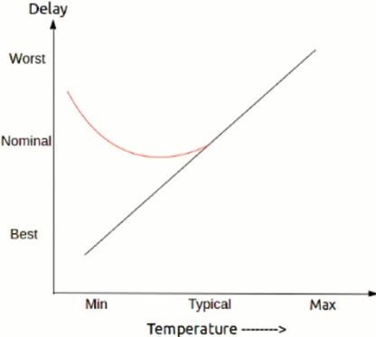
6 Macro Synthesis Guidelines
6.2.1 Macro Timing Constraints
Loading budget for outputs and driving cell for inputs. It's done to make sure that when our design is integrated into larger system it won't fail to drive cells after it, or fail to be drived from previous cells. It’s done by estimating an appropriate number of other major blocks our design may have to drive .
Operating conditions, including temperature and voltage : It’s also known as the sign-off corners .
block 1

Slide 8
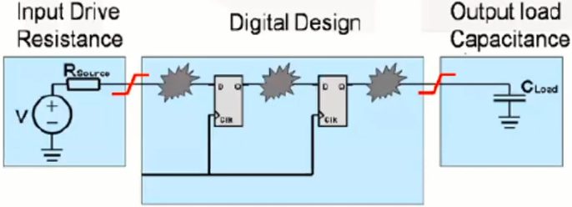
6 Macro Synthesis Guidelines
6.2.2 Subblock Timing Constraints Note– Regardless of any followed strategy for synthesis (top-down/bottom-up) It’s advisable for complex macros to develope sub-block timing budget . [By setting input_delay and output_delay constrains ] Rule – The basic timing constraints or budget must be developed for each subblock in the macro. -A good nominal starting point for the loading and driving specifications is to use a two-input NAND gate as the driving cell and a flip-flop data input pin as the output load.
set_driving_cell -cell [get_lib_cells LIB/BUF2] -pin X [remove_from_collection [all_inputs] [all_clocks]] set_load <number_in_femtofarad> [all_outputs]

Slide 9
6 Macro Synthesis Guidelines
6.2.3 Synthesis in the Design Process Guideline – A designer should run synthesis as soon as the RTL has passed the basic stage before fully debugging as this helps : -To identify & fixing timing problems early . -Saving design time as fixing timing needs modifying RTL so it’s better to do so before fully debugging . -To make sure that the desing is structured well as at early synthesis stage , The aim is to reach 10%-20% of the final timing budget . Guideline - The subblocks should meet all timing budgets, as well as meeting all functional verification requirements, before being integrated into the macro.

Slide 10
6 Macro Synthesis Guidelines
6.2.4 Subblock Synthesis Process Guideline – The subblock synthesis process consists of three phases:
Perform a compile on the subblock, using constraints based on the budget.
Perform characterize-compile or budgeting on the whole subblock, to refine the timing constraints and resynthesize the subblock.
Iterate if required.
Sub_Block

Slide 11
6 Macro Synthesis Guidelines
6.2.5 Macro Synthesis Process
Guideline –The top-down macro synthesis process consists of two phases:
1)Perform a characterize-compile or budgeting on the whole macro, using the top-level macro constraints.
2)If necessary to meet the timing goals, perform an incremental compile.
Guideline – The bottom-up macro synthesis process consists of three phases:
1)Perform a compile on each of the subblocks, using constraints based on the budget.
2)Perform a characterize-compile or budgeting on the whole macro to improve timing and area.
3)If necessary to meet the timing goals, perform an incremental compile.

Slide 12
6 Macro Synthesis Guidelines
6.2.6 Wire Load Models Wire load models estimate the loading effect of metal interconnect upon cell delays. For deep submicron designs, this effect dominates delays, so using accurate wire load models is critical. A statistical wire length is determined based on the physical size of the block[By the gate count (and thus area) of the entire macro at the top level.]. From this statistical wire length and the total input capacitance of the nodes on the net, the synthesis tool can determine the total load on the driving cell as follows : R= length of estimated wire * Resistance per unit length (Given in .lib file). C= length of estimated wire * Capacitance per unit length (Given in .lib file). **Note: When we synthesize a subblock, we must use the wire load model for the full macro and not the wire load model for the sub-block .

Slide 13
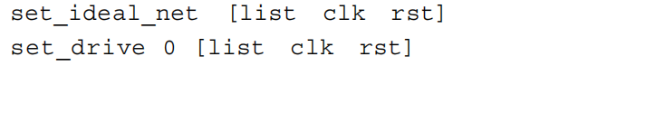
6 Macro Synthesis Guidelines
6.2.7 Preserve Clock and Reset Networks For clock networks : -The aren’t initially synthesized till physical synthesis stage (CTS) then a balanced tree of buffers will be inserted to achieve low skew . For Asynchrounous resets : They are treated the same till physical synthesis stage (HFS) Guideline –1) Set ideal_net on clock and asynchronous reset networks to disable optimizing those paths in timing . 2) perform a set_drive 0 (infinite drive) on these nets to specify resistance values on specified inputs to be zero . Ex.

Slide 14
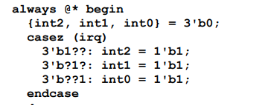
6 Macro Synthesis Guidelines
6.2.8 Code Checking Before Synthesis Design checking tools can quickly check for many different potential problems including:
Presence of latches .
Non-synthesizable constructs like“===” or initial block .
Whether a case statement was inferred as a mux or a priority encoder due to non-Parallel case statements where more than one statement input could match one input pattern Ex.(at irq=3’b011 , case 2 & case 3 are matched ).
Whether all bits in a bus were assigned.
Unused macros, parameters, or variables.
Non-parallel case statement

Slide 15
6 Macro Synthesis Guidelines
6.2.8 Code Checking Before Synthesis Synthesis Tools
Once the RTL passes the design checking tool, the elaboration reports from synthesistools should be examined to check:
Whether sequential statements were inferred as flip-flops or latches.
Whether synchronous or asynchronous reset was inferred.
Unexpected flip-flops or latches.

Slide 16
6 Macro Synthesis Guidelines
6.2.9 Code Checking After Synthesis After synthesis, the synthesis tool can be used to run a number of checks. The Design
Compiler syntax for some of these is as follows:
Loop Checking:
Run report_timing -loops to determine whether there are any combinational loops.
Checking for Latches
Run all_registers -level_sensitive to get a report on latches in the design.
Check for Design Rule Violations
Run check_design to check for missing cells, unconnected ports, and inputs tied high or low.

Slide 17
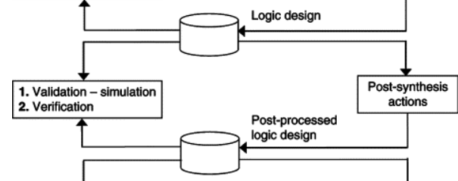
6 Macro Synthesis Guidelines
6.2.9 Code Checking After Synthesis Verify Testability:
Run check_test to verify: 1) That there are scan versions of all flops.
2)Checking for any untestable structures .
To make sure that the scan on the chip-wide basis & The ATPG will be successful ,Since soft macros are’not shipped with scan flops yet scan flops are inserted on the chip-wide . Verify Synthesis Results [Formal Verification]
Use an equivalence-checking tool to verify that the RTL and the post-synthesis
netlist are functionally equivalent.

Slide 18
6 Macro Synthesis Guidelines
6.3 Physical Synthesis
By moving forward to smaller technologies the wire model becomes more inaccurate to estimate post layout timing(due to interconnects delay ) . - So we need to perform a physcial synthesis on macros before releasing them especially timing critical macros .

Slide 19
6 Macro Synthesis Guidelines
6.3.1 Classical Synthesis In the past synthesis process wasn’t automated so : 1-Synthesis had no feed back from floorplan or placement stages [Their effect wasn’t taken for consideration ]. 2-Manual iteration between synthesis and placement was very slow . 3-Layout had to be redone from scratch if there’s an adjustment in synthesis process. This lead into a big problem when transistors cells became smaller and faster and the load effect and interconnects delays became a major portion .

Slide 20
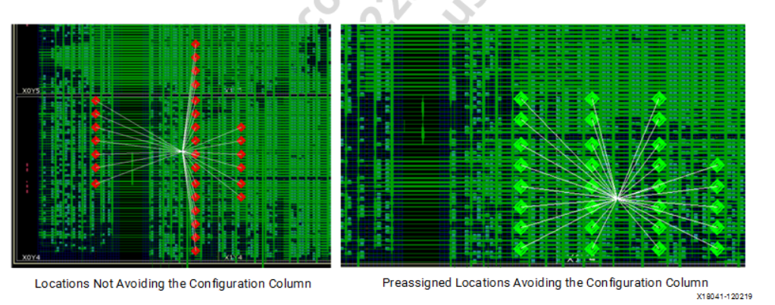
6 Macro Synthesis Guidelines
6.3.2 Physical Synthesis -placement is the key physical information needed to predict delays as with a large routing layers , Routing delay is predictable once placement is done . Physical synthesis requires the designer to provide the physical constraints for the design as well as the timing constraints. These constraints include:
Physical size of the macro
Net weightings—which nets are most timing critical .
Pin locations
Grouping information[Ex. Grouping Critical Logic to optimize critical paths]
In this Example , On the left: The placer was unable to find a proper placement for a FIFO primitives [Red cells] as RAM had a high utilization. On the Right :The placer found a proper placement for the FIFO primitives after grouping all FIFO blocks together in rectangular that avoided crossing the configuration column [I/O column].

Slide 21
6 Macro Synthesis Guidelines
6.3.3 Physical Synthesis Deliverables Physical Synthesis is done regularly for developing a test chip yet for aggressive performance goals designs it’s necessary for providing some physical synthesis deliverables to the integrator . -These deliverables should also contain notes on how to perform physical synthesis to the macro and should include sample scripts that shows how to define: -The physical size of the macro . - The pin locations. - The grouping information. -The net weighting schemes. A proper net weighting scheme would assign higher weights to more timing critical nets, hoping that the placer will reduce the wirelength of these critical nets and hence, the delays on these paths can be reduced.

Slide 22
6 Macro Synthesis Guidelines
6.4.1 Memory Design On-chip RAM architectures are differentiated by their architecture and their speed nad timing-area tradeoffs.
Small memories up to about 1000 bits. | Memories in range of 1-8K bit range | Larger memories [Over 8K bits]
-Flop- and latch-based memories are optimal Ex. FIFO designs up to 32x32. -The Advantage of these memories is that they can be coded in RTL, and thus are technology independent and completely reusable. | -Register files are optimial . -Register files are not technology independent. -they are often easier to port to new processes than are true memories. -They use a custom memory cell that is smaller than a standard cell latch, but larger than a true memory cell. -They have a larger fixed overhead [decoders and muxes]. -Reg files are used as multi-port memory . | -The bits cells are designed to be as small as possible to optimize the area . -Specialized memories are available with more ports for specific applications. -These memories have rather large fixed overhead [decoders, muxes, and sense amps] but is still small compared to the area of the bit cell array. -They are technology dependant . -The are also challenging to port to new processes and have a complex timing due to using precharge and sense amps.

Slide 23
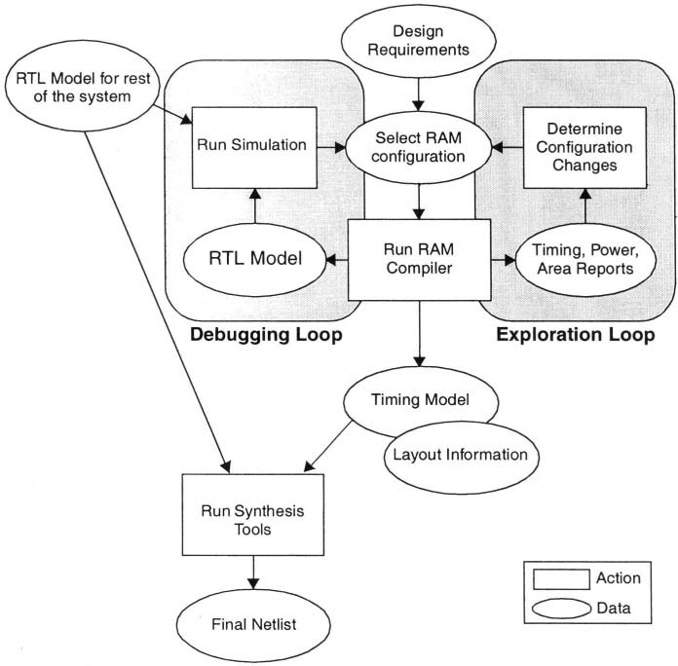
6 Macro Synthesis Guidelines
6.4.2 RAM Generator Flow The typical work flow for the user the user of a RAM generator. The designer:
Describes the memory configuration, through either a GUI or a command-line interface.
Selects the family of memory, typically trading off power, area, and speed.
Invokes the memory compiler, which produces a simulation model andsynthesis model for the memory, as well as physical layout information.
Performs simulation with models for the rest of the system to verify the functionality of the memory interfaces.
Performs synthesis with the synthesis model for the RAM and the RTL for the rest of the design .

Slide 24
6 Macro Synthesis Guidelines
6.4.3 Datapath Design It is necessary to exploit hardware structure to achieve a faster, smaller, or lower-power design. Ex. The functionality of a 32-bit multiply-accumulate
block is clear and does not help differentiate a design . So to compete optimizations must be a major consideration .

Slide 25
6 Macro Synthesis Guidelines
6.4.3 Datapath Design Datapath Design Issues There are three major problems with traditional approaches to datapath design:
-Irregular structures like Wallace tree multipliers can outperform regular structures. -The datapath designs produced are not portable to new technologies and do not lend themselves to reuse. -The great majority of modern applications are poor candidates for the traditional approach. yet these traditional approaches can be applied to simple and regular designs .

Slide 26
6 Macro Synthesis Guidelines
6.4.3 Datapath Design Datapath Design Tool Evolution
These handcrafted designs [In the past] : | layout-oriented datapath design tools [Automating regular / bit-slice designs ]
-Consist of regular datapaths [Can be built out of a specified blocks like adders and muxes] . -The physical design was laid out for a single bit slice of the datapath, then replicated. -High performance because the methodology effectively exploited the regular structure of the logic -Low productivity because of the amount of handcrafting required -Poor portability because the results were design and technology specific. | -Structural descriptions of the design are entered either in schematic form or in HDL . -High performance for regular structures -Poor performance for irregular, tree-based structures like Wallace-tree multipliers -Poor performance for structures with varying bit widths, a common characteristic digital filters, or any other design employing techniques like saturation, rounding, or normalization . -Moderate productivity because of the automation of design tasks . -Poor portability because designs were still technology-specific

Slide 27
6 Macro Synthesis Guidelines
6.4.3 Datapath Design Datapath Design Tool Evolution
Data-Path synthesis tools :
-High performance: Implementation exploration allows superior designs -High productivity: Fast synthesis times allow very rapid development of very complex designs -High portability: Because the source is technology independent and can be parameterized, it is very portable across technologies and from design to design

Slide 28
6 Macro Synthesis Guidelines
6.5 Coding Guidelines for Synthesis Scripts
Guidelines | Rules
– Keep the line length to 72 characters or less. *For dc_shell commands, use a backslash (\) to continue the statement onto the next line. –– Run the syntax checker on synthesis scripts before running the script. Ex. dc_shell -syntax_check -f \ ./scripts/my_compile.scr | - All synthesis scripts should begin with a header describing the file, its purpose, its author, and its revision history. -Comments should be used extensively to describe the synthesis strategy being executed. -All scripts used to build the design should be under revision control and a bug tracking system. – Variables should be used in the body of the script and their values set at the top of the script. – No hard-coded paths should appear in any scripts as they aren’t portable . -Scripts should be as simple as they can be and still meet their objectives -Common commands such as those defining the library and search paths should reside in a single setup file. -Synthesis scripts for parameterized soft macros need to be tested as thoroughly as any source code.

